Slide 1
Computer Science
Summer Springboard

Slide 2
Day 1 - Introductions

Slide 3
Allow me to introduce myself…
Professor introduction

Slide 4
Your turn!
Name?
Hometown?
Favorite book / movie / show?
What are you interested in studying?

Slide 5
Now, let’s introduce Computer Science!

Slide 6
What is Computer Science?
Computer Science is the study of computers and computational systems. This includes their design, development, operation, and application. Computer Science encompasses a wide range of topics and areas of research pertaining to the use of computers and computational techniques to solve problems and process information.

Slide 7
What is Computer Science (cont’d)
There is a lot to break down in that definition!
However, the key takeaway is…

Slide 8
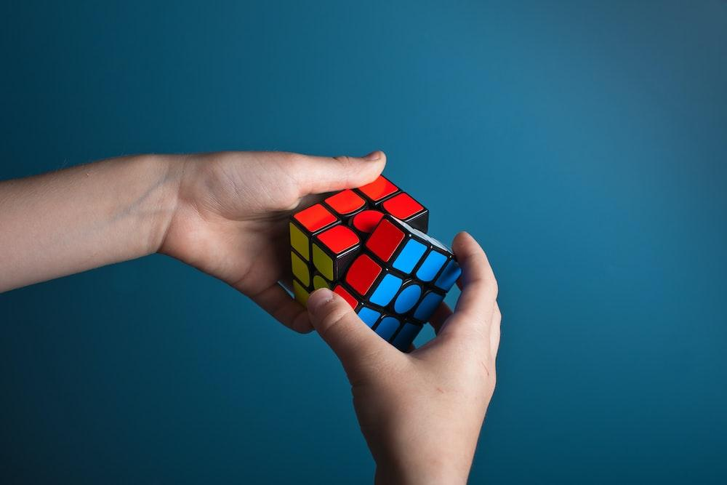
Problem Solving!

Slide 9
What is Computer Science? (cont’d)
Computer Science is all about solving problems
Not just solving problems, but solving them to the best of our ability
Coding is an important part of this puzzle, but not everything
You may be interested in…

Slide 10
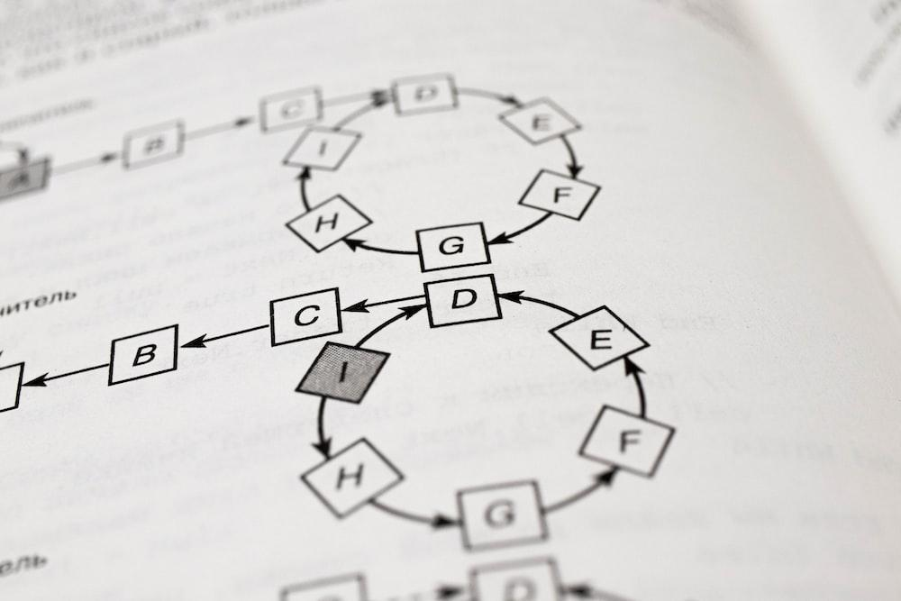
Algorithms and Data Structures
Algorithms: sets of instructions to solve specific problems
Data Structures: ways to store and organize data efficiently

Slide 11

Cybersecurity
The practice of protecting systems, networks, and programs from digital attacks. This includes cryptography, network security, information security, etc.

Slide 12

Human-Computer Interaction
This field focuses on the design and use of computer technology, particularly the interfaces between users (humans) and computers

Slide 13
And so much more!
Computer Science is such a vast field that there is a niche for everyone
For the time being, let’s focus on coding

Slide 14
So what’s coding?
Coding is the process of creating instructions for computers using programming languages. It is a fundamental aspect of developing software, applications, websites, etc etc etc.

Slide 15
Coding Breakdown! Coding involves…
Writing code (of course): at its core, coding involves writing the lines of code that tell a computer what to do using a programming language. Each language has its own syntax and specific use cases.
Problem solving (here it is again): programmers use code to create algorithms and solutions to specific tasks or challenges, whether it be calculating numbers, sorting data, automating tasks, … the list goes on.
Creativity and expression: coding allows for creative expression (think video games, digital art, interactive websites).
Continuous learning and adaptation: coding is always changing. There are always new languages, frameworks, and technologies. Coders have to be able to learn and adapt to keep up with the latest developments.

Slide 16
Okay, Computer Science is big and important blah blah blah. But what’s our goal?
Our goal is to get our feet wet in the world of computer science, specifically through coding.
We will be learning the basic ins and outs of a programming language that is becoming increasingly important and popular…

Slide 17
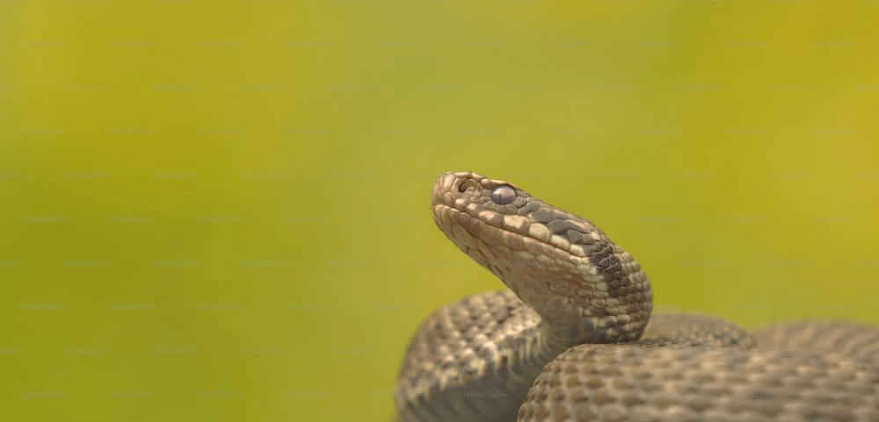
Python!
Wait… not THAT type of python.

Slide 18

Python!

Slide 19
Why Python?
There are so many programming languages to choose from
C / C++
Java
Haskell
F#
Rust
Dare we mention Assembly?
So why are we using Python?

Slide 20
Why Python? (Cont’d)
Python is beginner-friendly
Clean, readable syntax
Indentation enforces consistent, pretty code
Python is versatile
Machine learning
Scientific computing
Scripting
So, so, so much more
Python is popular
Large, active community of helpful developers
Abundance of libraries and frameworks

Slide 21
So where did Python come from anyways?
Development on Python began in the late 1980s when Guido van Rossum started working on it during his Christmas break.
His goal was to create a language that would overcome the limitations of ABC, a language he worked on previously.
Python (said to be named after Monty Python’s Flying Circus) would publicly launch in February of 1991.

Slide 22
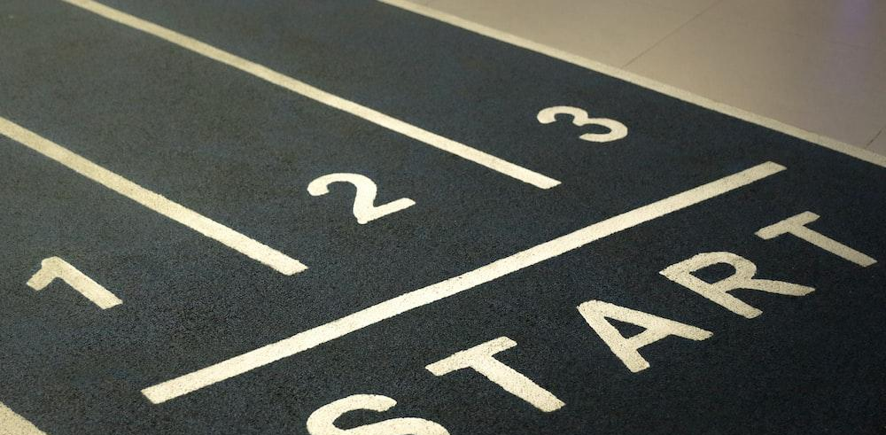
Ready?
If you are ready, let’s begin!

Slide 23
Finite Automata
“Wait that’s not Python!!!”
Yes, the astute among you may notice that the title of this slide is not Python. Nonetheless, this is a great place to start.

Slide 24
Finite Automata (Cont’d)
A finite automaton is a computational model used in computer science to represent and recognize patterns in strings (some sequence of symbols e.g. this sentence).
Although these are not particularly relevant to everyday use of Python, there are many reasons that studying them will be helpful for us.

Slide 25
Why finite automata?
Learning about finite automata will help…
Our algorithmic thinking: understanding finite automata involves breaking down problems into smaller, well-defined steps.
Pattern recognition: finite automata are often used to recognize patterns or sequences in strings. This will be useful in Python test processing, parsing, and data validation.
Introduce us to theoretical concepts.
Our understanding of state machines: it is crucial to understand state machines when designing complex systems or simulations in Python, such as game development or control systems.

Slide 26
Alright, so what is a finite automata anyways?
A Deterministic Finite Automaton is a tuple {Q, Σ, q₀, F, δ} where:
Q is the (finite) state of states
Σ is the alphabet (finite set of symbols used as input)
q₀ is the start state
F is the set of final states
And δ is the map Q × Σ → Q

Slide 27
That’s too scary!!!
What does all of that even mean?
Long story short: don’t worry about it for now
Without getting too deep into the nitty-gritty, we will be working with some simple deterministic finite automata (DFAs)
For now, just think of a DFA as a special kind of game that follows specific rules to decide of something is true or not (visual on the next slide)

Slide 28
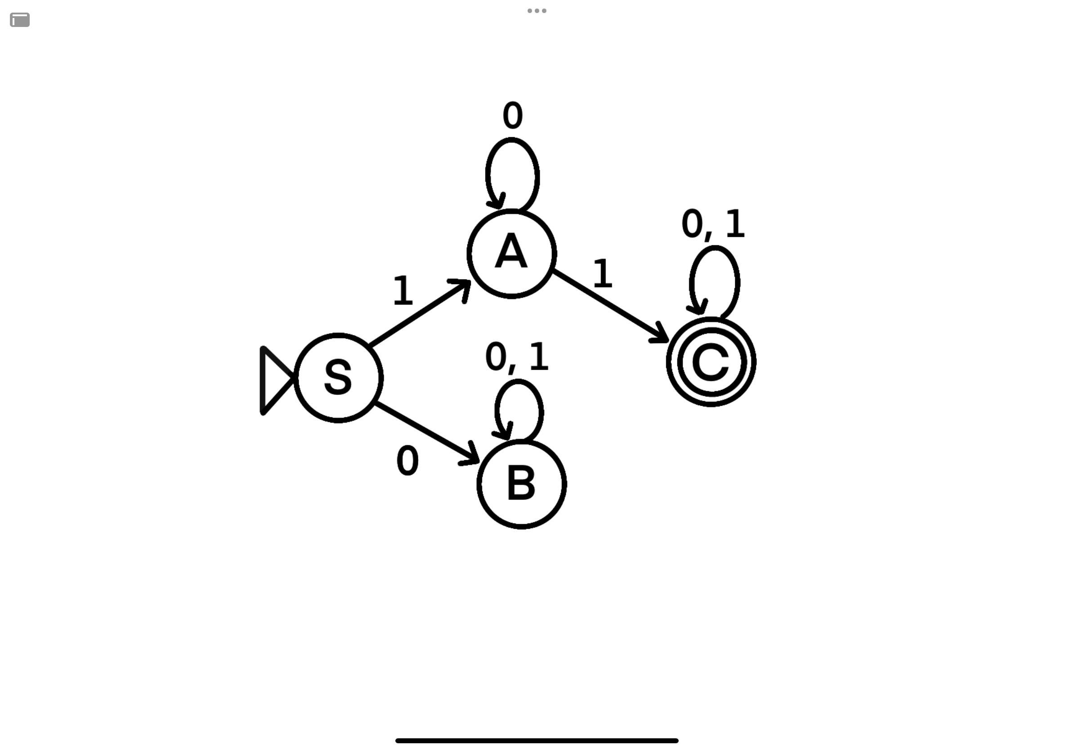
DFA Visualized

Slide 29
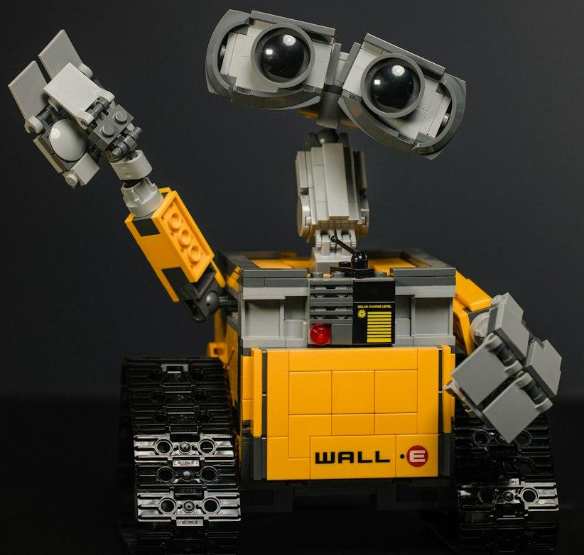
DFA Explained
Imagine you have a robot that lives in a world with a few rooms connected by doors. Each room has a rule about which door the robot can go through next, based on a secret code you give it, like a series of yes or no questions. Here is how the game works:

Slide 30
DFA Explained (Cont’d)
Starting room: The robot starts in a special room, which is its home. This is the circle that has a triangle on its side

Slide 31
DFA Explained (Cont’d)
Secret code: You give the robot a secret code made of simple stamps, like: “Step 1: Say ‘1’, Step 2: Say ‘0’”, and so on.
Moving around: depending on each step of your secret code, the robot moves from one room to another. Each room tells the robot where to go next when it hears ‘1’ or ‘0’.
For example, if we tell the
robot “1” first, it will go from
S to A, but if we tell it “0”
first, it will go from S to B

Slide 32
DFA Explained (Cont’d)
End of the game: When the secret code ends, the robot stops moving. If it stops in a special room (denoted by a circle inside of a circle), it means your secret code wins the game! If it stops in any other room, the code doesn’t win.
For example, if we say “1 1 0”, the robot will go from S to A and finally to C, which is a special room, so 110 wins the game.
Happy
robot!

Slide 33
That’s not so bad!
Seems simple enough, right?
So, what are all of the secret codes that will help us win the game?
1 1 0 works
1 0 1 works
1 1 1 1 1 1 1 1 1 1 1 1 works
What else works?
Think about this for a few minutes with a partner.

Slide 34
The Answer
Well, it turns out that an infinite amount of codes will work.
But not every code; i.e. 0 0 0 does not work
So, the answer is that any code that starts with a 1 and has at least one other 1 later in the code will work.

Slide 35
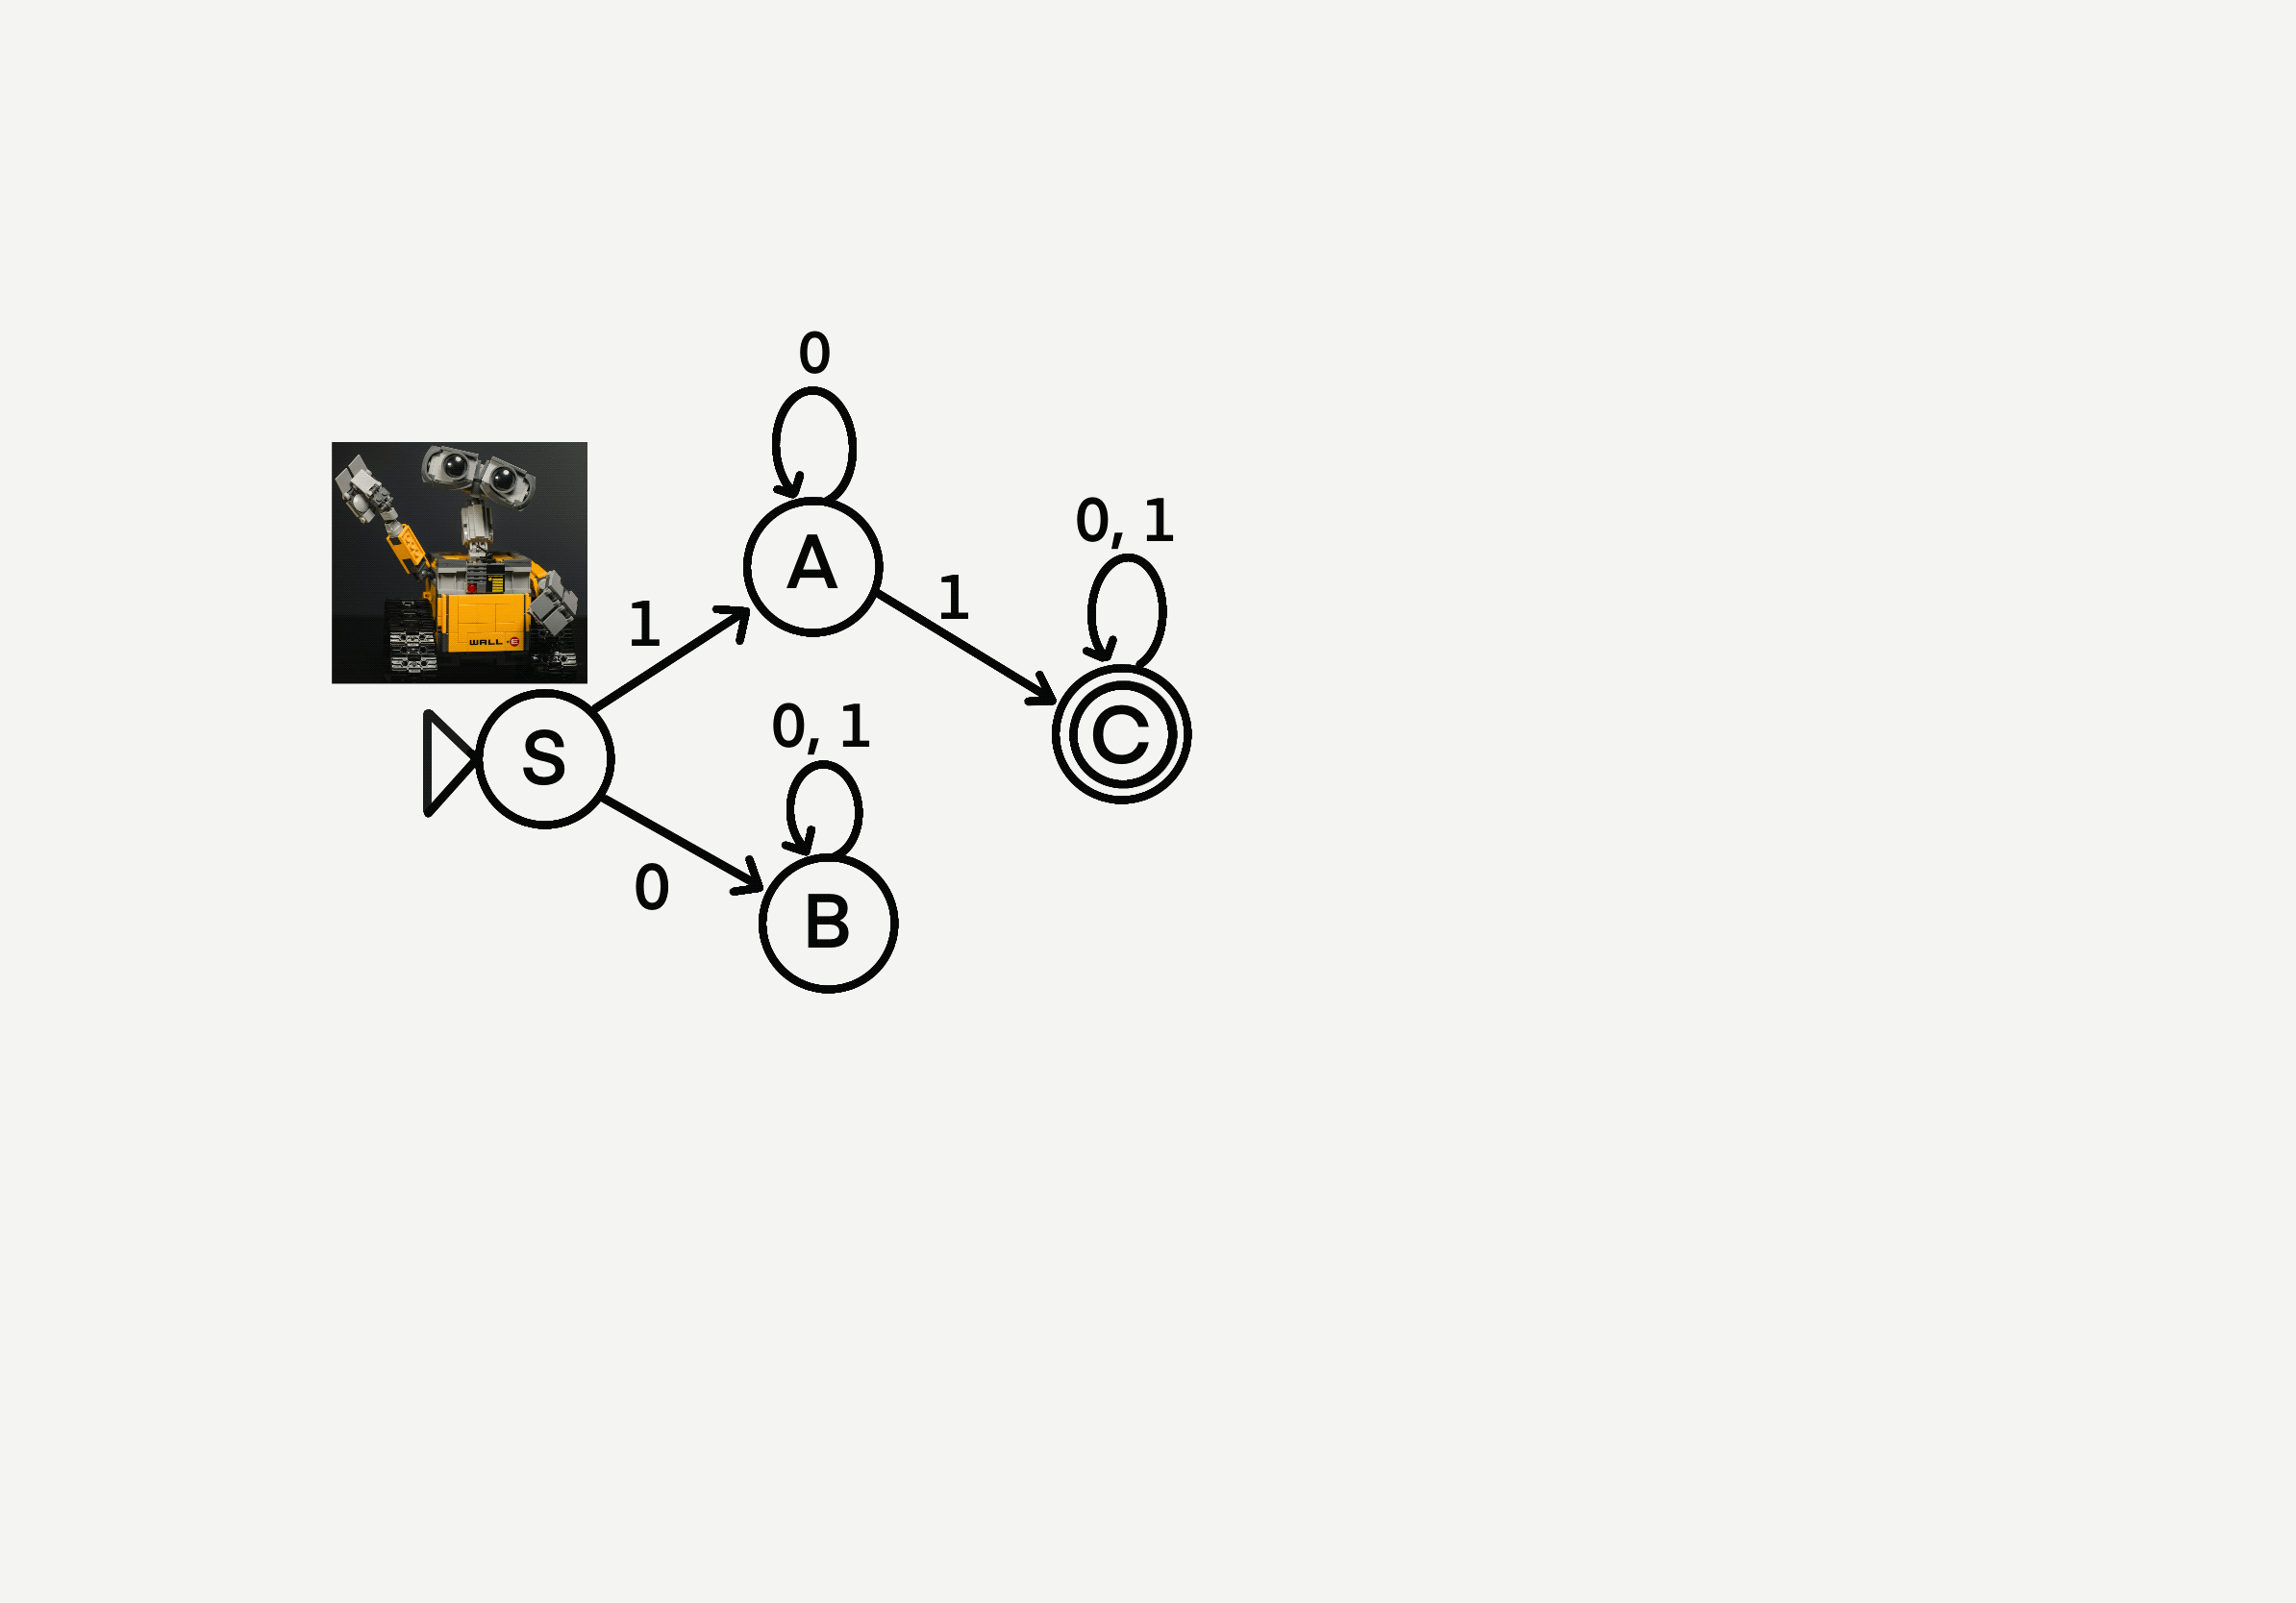
Let’s see this animated with the code 100111
Notice that when we reach C, our
code continues; we just keep
looping back to C.

Slide 36
One more example
Let’s say we have a DFA which uses the letters {C, A, T}
Since the robot follows very specific directions, each room that it is in needs to have an instruction for if the robot receives any given letter. For example, if the robot is in room 2, it needs to know what room to go to if it is given ‘C’, if it is given ‘A’, and if it is given ‘T’.
Let’s see what a DFA would look like with the secret codes “CAT” and “AT”.

Slide 37
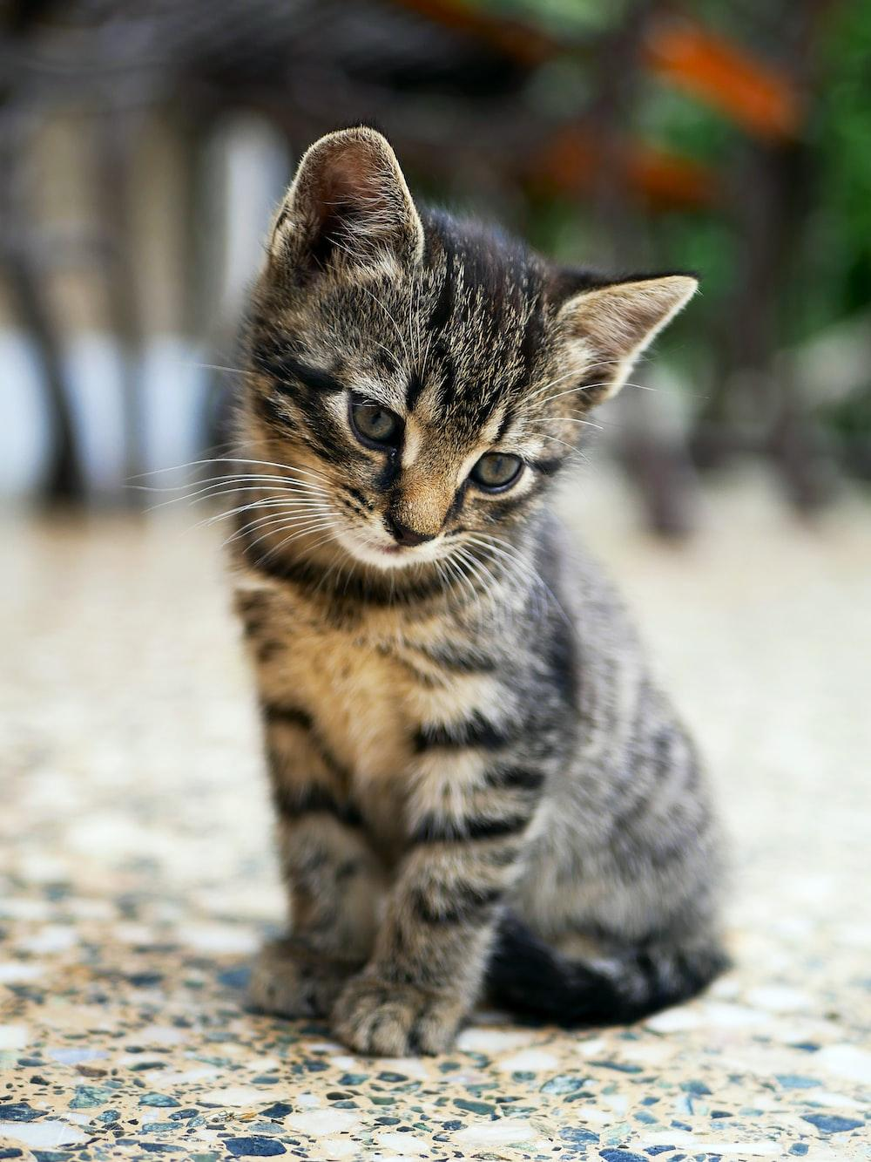
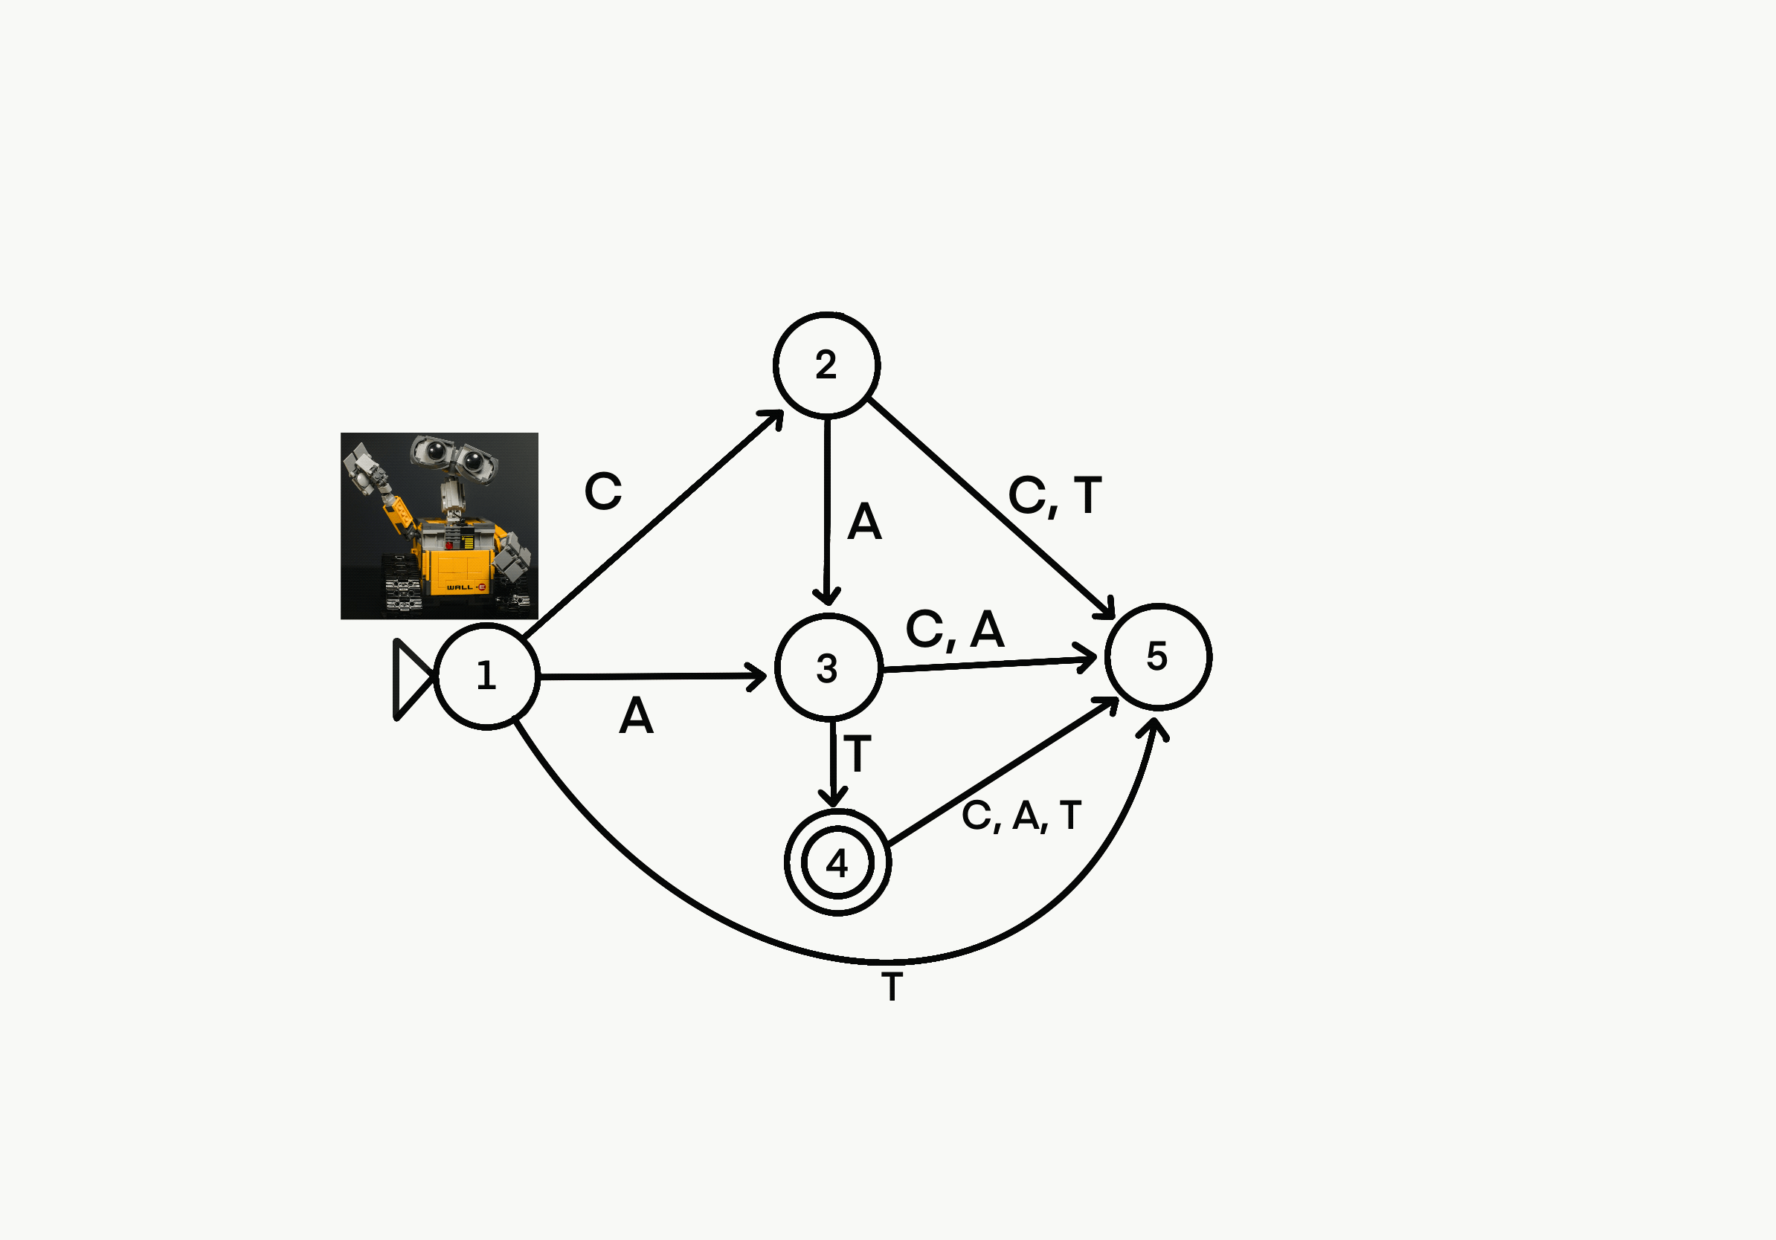
{C, A, T} DFA Animated
Notice how we win if we enter a winning code like CAT, but if we enter a losing code like CATT, we lose. The only two winning codes here are CAT and AT. No other code will have us end on our special room, 4.
Note: This is certainly not the only way to draw this DFA! There are other valid ways to meet our specifications.

Slide 38
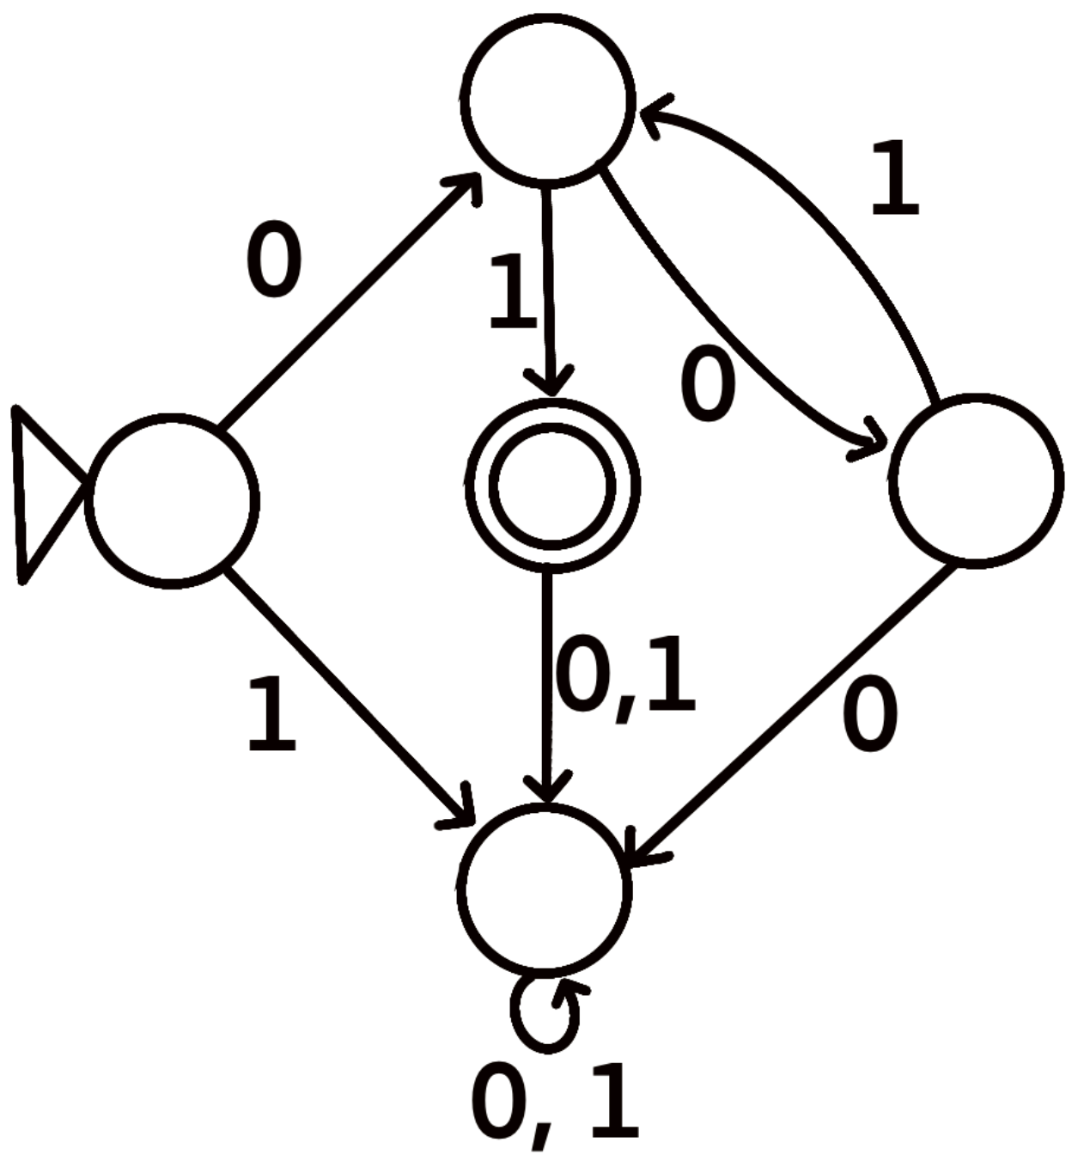
Your turn!
Our robot finds itself in a two new worlds and it needs your help!
Design a world that works with the letters {A, N, T} that has winning codes “A”, “ANT”, and “TAN”. Get help from a partner or group if needed! [20 minutes]
Determine all winning codes for the DFA pictured below. Once again, get help from a partner or group if needed! [15 minutes]

Slide 39
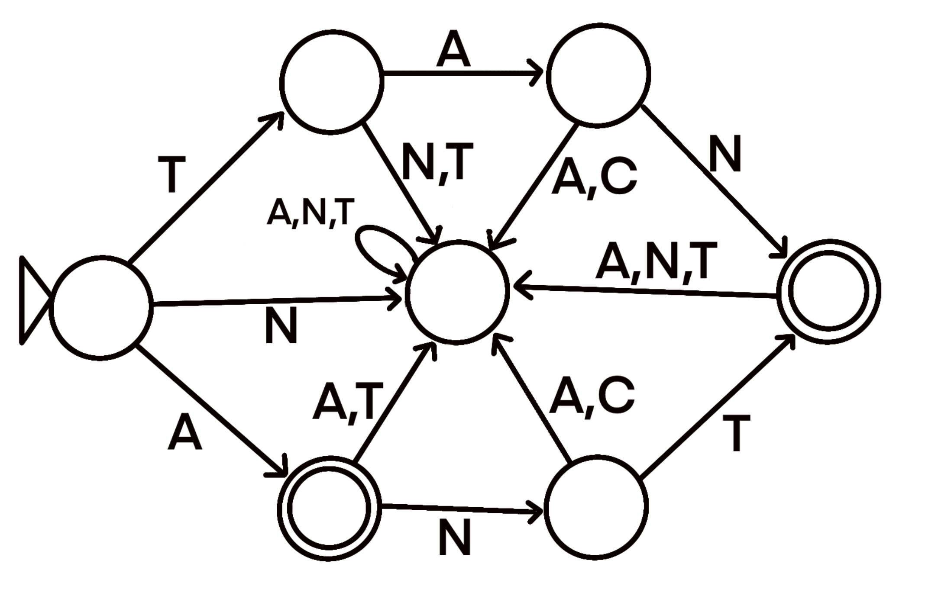
Answers
Here is a sample solution (many possible solutions exist):

Slide 40
Answers (Cont’d)
2. This DFA accepts all codes which start with a 0, then contain any number of repetitions of the sequence 01, followed lastly by a single 1.
Examples include:
0 1
0 01 1
0 01 01 01 01 01 01 1
Non-examples include:
0
1
0 1 1
0 0 1
0 0 0 0

Slide 41
DFA W(rap)up
♪♪♪Jumpin’ through states like a hopscotch game,♪♪♪
♪♪DFA’s the name, determinism’s the fame,♪♪
♪♪♪Follow my rules, no guesswork in my lane!♪♪♪
All jokes aside, those last couple of questions got complicated real fast! And our alphabet was small; imagine using the whole set of letters in the English alphabet! There is so much more to know and learn about automata, but it would take a semester-long class to even start to do this topic justice. We got what we wanted out of it for now though: we strengthened our critical thinking and problem solving skills, while getting into the mindset of a computer. When we begin coding in Python, we will see that the computer interprets things in a similar way to what we just did; it reads our code step-by-step, line-by-line.

Slide 42
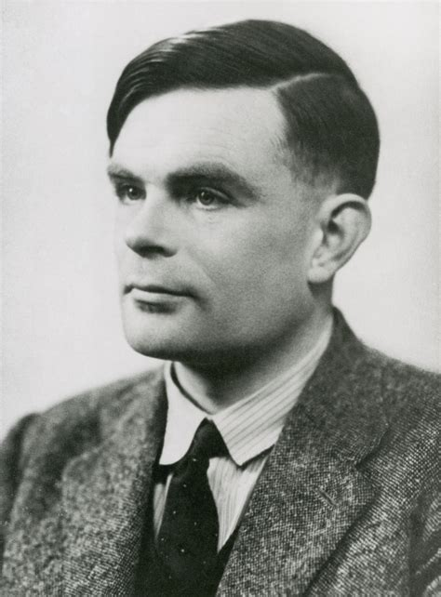
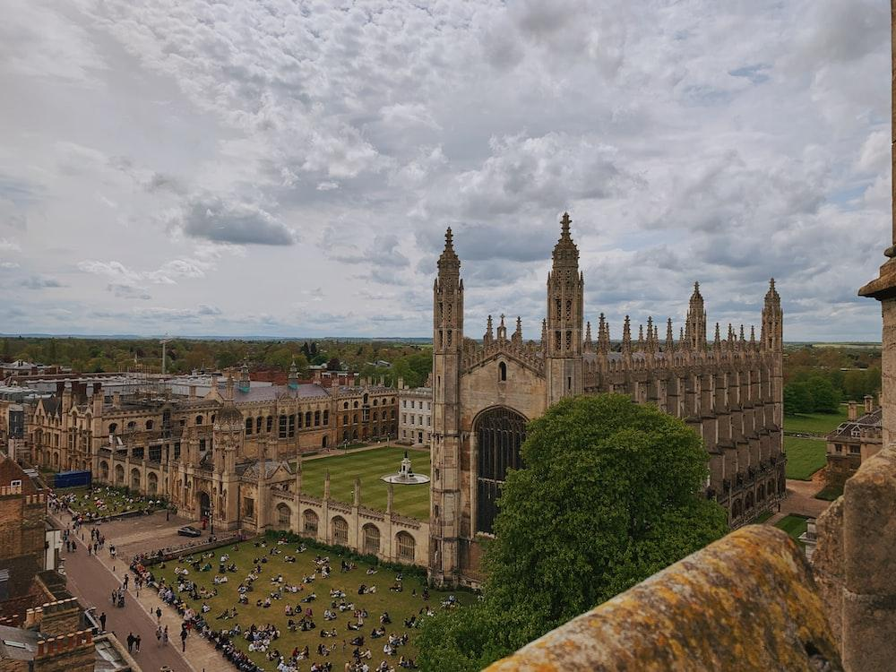
Want to learn more about this topic?
https://en.wikipedia.org/wiki/Finite-state_machine
https://en.wikipedia.org/wiki/Context-free_grammar
https://en.wikipedia.org/wiki/Turing_machine
Keep at this topic, and eventually you’ll learn about the Turing machine!
Alan Turing, Cambridge alumnus ->

Slide 43
Alright, back to Python
Most likely, your computer does not automatically have Python available and ready to use
So, let’s fix that by installing Python!

Slide 44
Python Installation

Slide 45
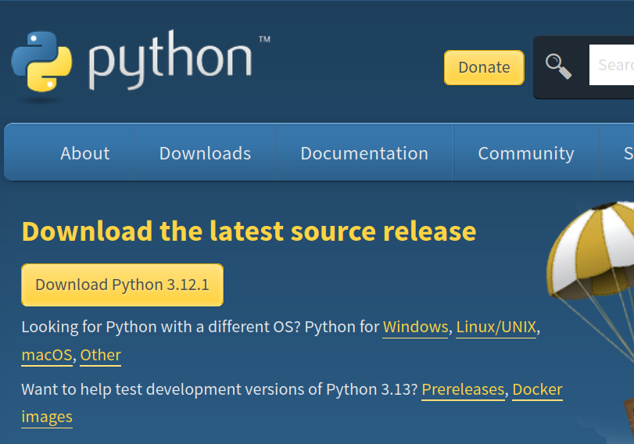
Python Installation (Step 1)
First, navigate to https://www.python.org/downloads/

Slide 46
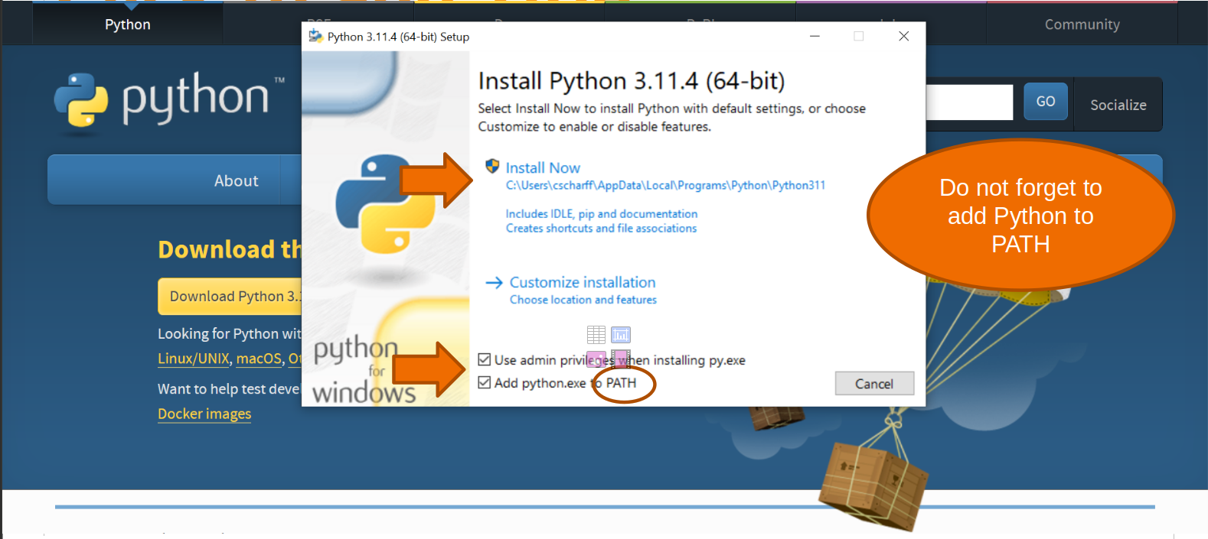
Python Installation (Step 2)

Slide 47
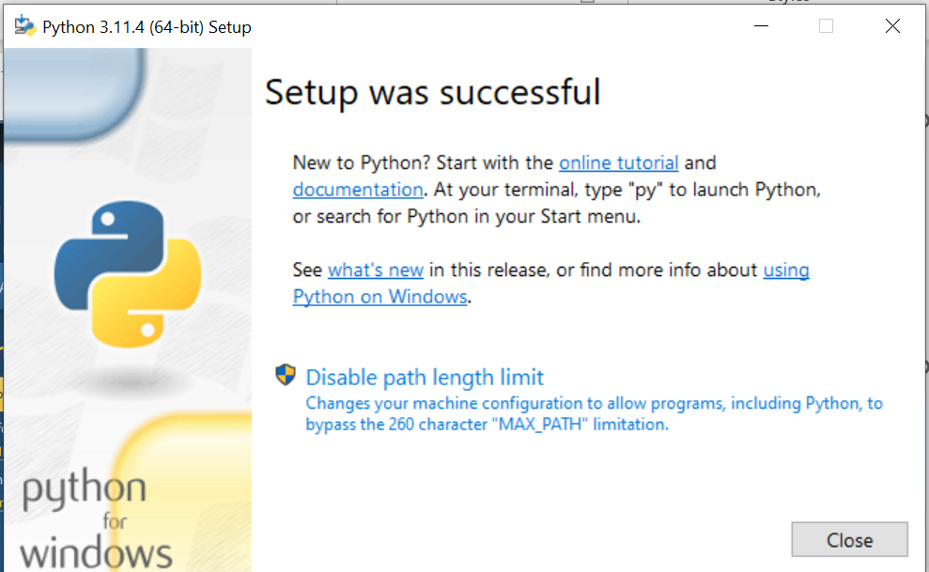
Python Installation (Step 3)

Slide 48
Python Installation (Step 4)
Make sure that Python is installed by opening your terminal (type ‘terminal’ into the search bar) and type either:
“python3 --version” or “python --version” and press enter.
You should then see something like this show up:
“Python 3.10.12”

Slide 49
IDE’s
We could write .py files directly and run them through the command line, but that is a lot of work.
Instead, let’s use an Integrated Development Environment, which is an application that programmers use to write and test their code. It is like a toolbox for coding, combining functions like code editing, error checking, running / testing code, and much more!

Slide 50
Visual Studio Code and Google Colab
Visual Studio (VS) Code: super popular, open-source IDE from Microsoft. It is versatile, has extensive plugin support, and strong integration with various programming languages and tools.
Google Colab: free, cloud-based platform that allows you to write and run Python code. It is primarily used for education, data analysis, and machine learning.

Slide 51
IDE Setup
We will install VS Code so that you can use it on your own time. It is very nice and will be very useful when you are more advanced.
For now, we will use Google Colab for simplicity.

Slide 52
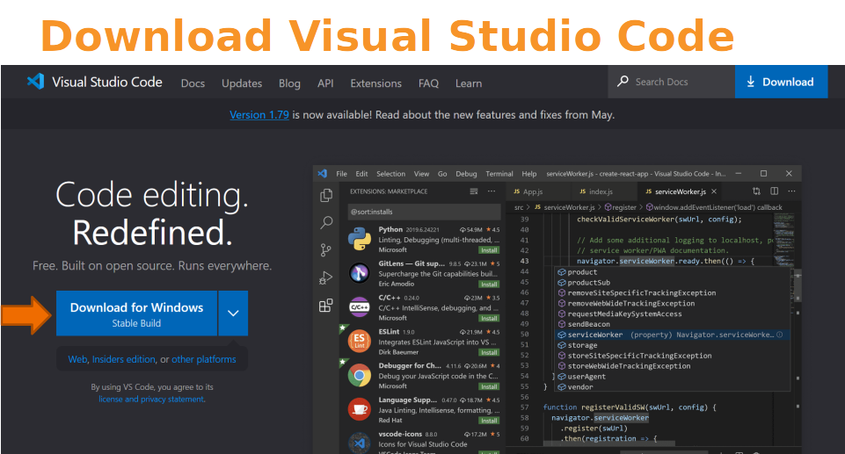

Slide 53
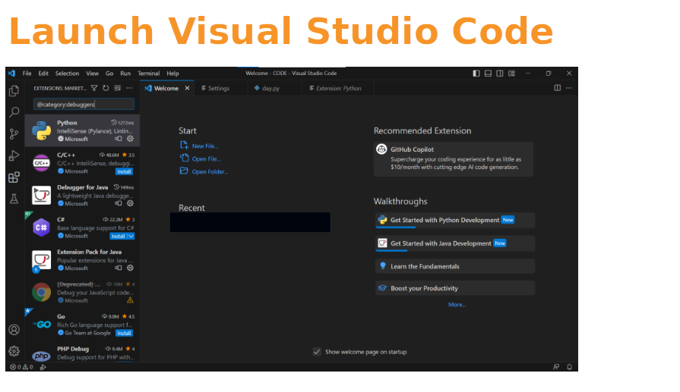

Slide 54
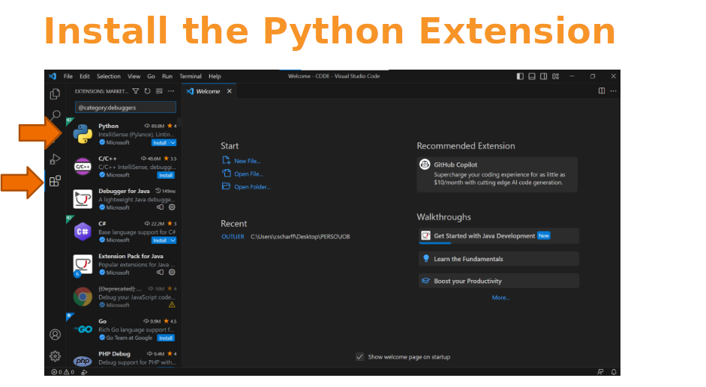

Slide 55
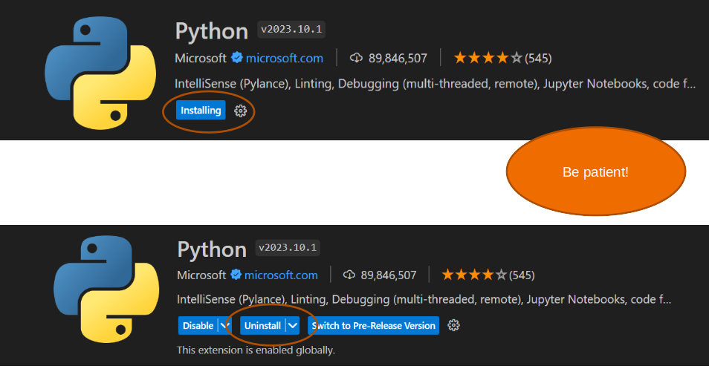

Slide 56
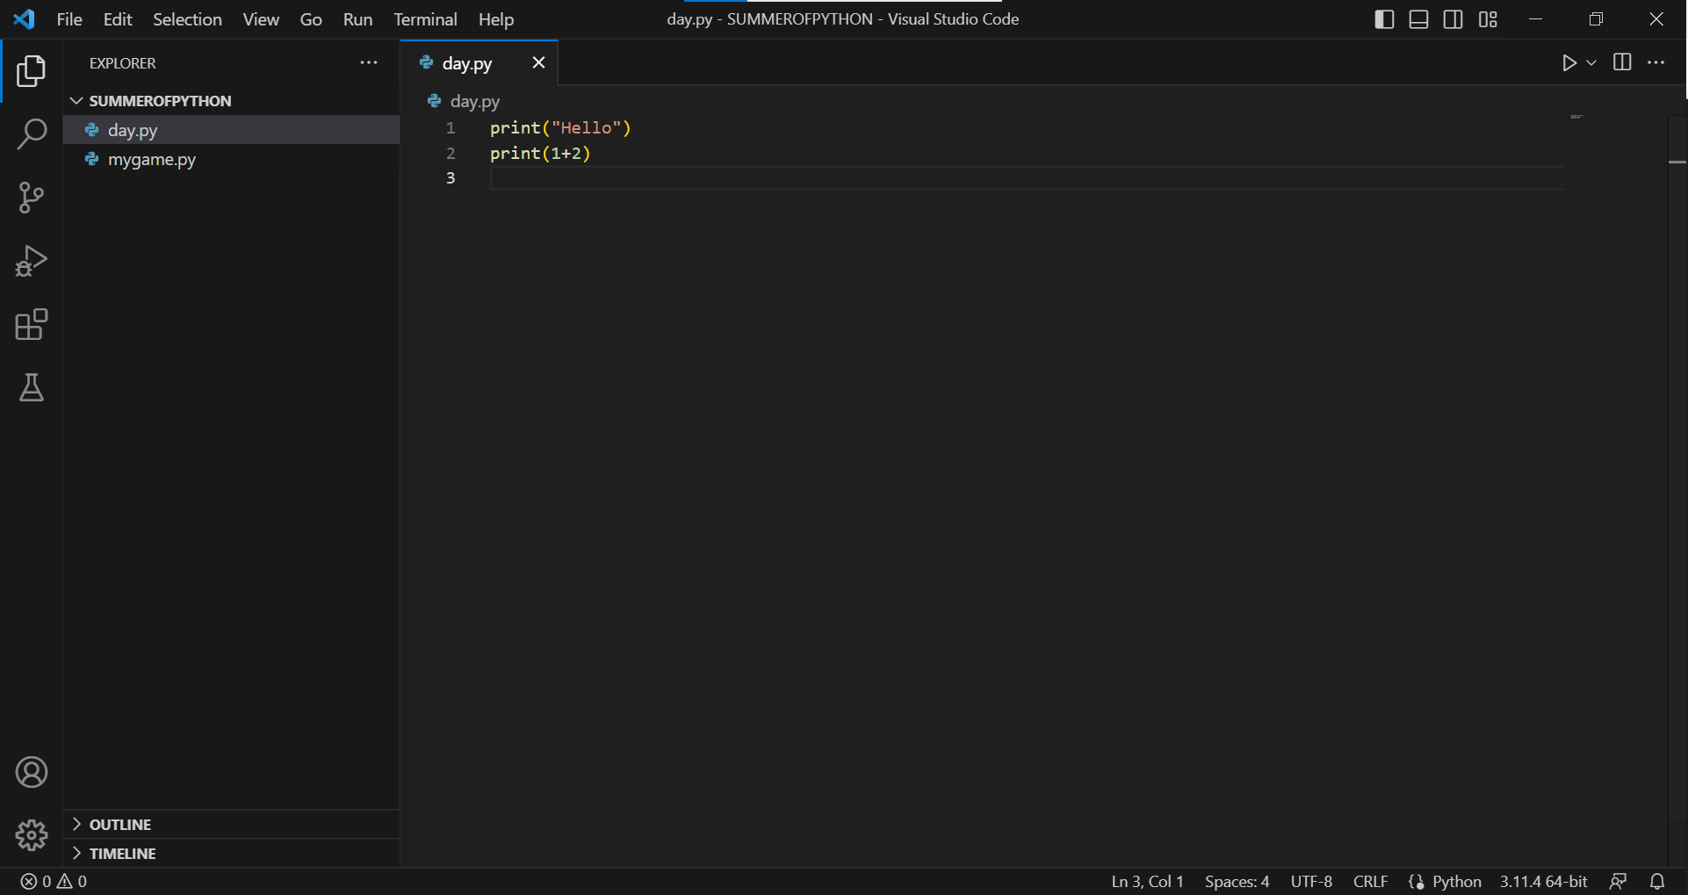
Create a folder on your computer, open it and start coding

Slide 57
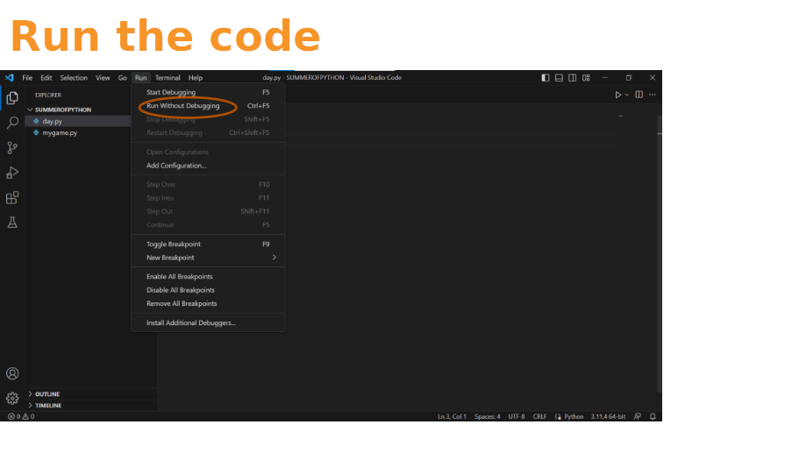

Slide 58
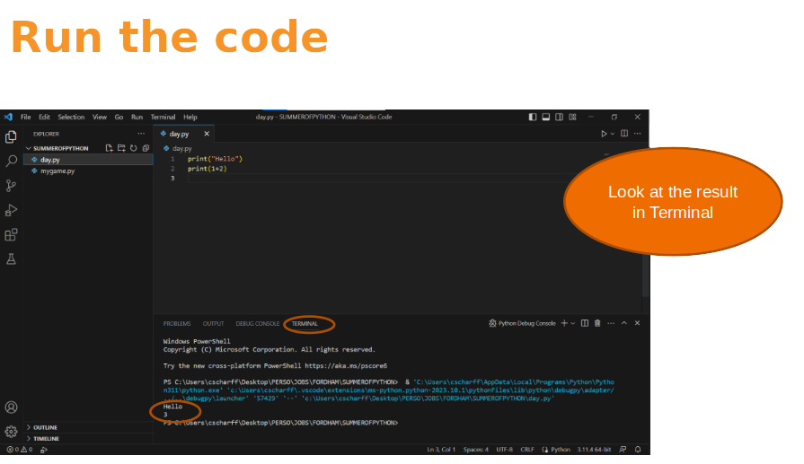

Slide 59
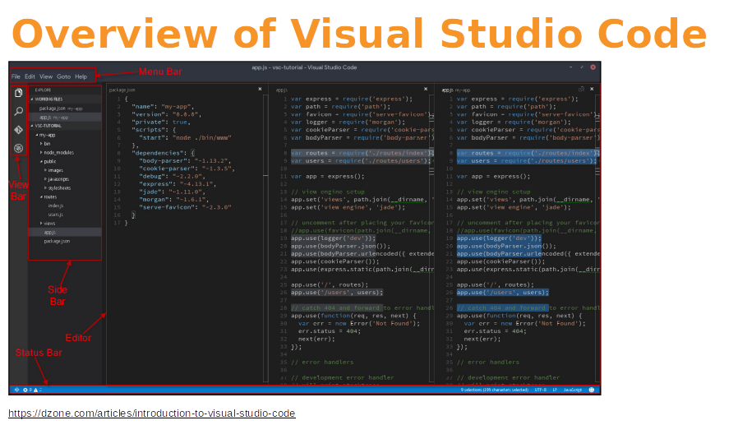

Slide 60
Google Colab
https://colab.research.google.com/
The cool part is: no setup and no downloads are needed! Just navigate to this website and you are set.

Slide 61
Time to Code!

Slide 62
Quick Summary
Before we jump over to today’s notebook, lets cover a few important topics:
Comments
Print
Binary Operators

Slide 63
Comments
A comment is a piece of text in your code that is not executed by the computer
It's used to leave notes for yourself or others to explain what the code is doing. In Python, you can make a comment by putting a hash symbol (#) at the start of the line.
Everything after the # on that line is treated as a comment and ignored by Python when running the code.
For example, # This is a comment in Python.

Slide 64
Print
Print is a function in Python that is used to output data to the console, make it visible to the user.
To use ‘print’, type ‘print()’ and put what you want to display inside the parentheses.
For example, ‘print(“Hello World”) will display the text “Hello World”

Slide 65
Binary Operators
Binary operators in Python are used to perform operations on two operands (values or variables).
Examples: + (addition), - (subtraction), * (multiplication), and / (division).
To use a binary operator, place it between two values or variables
For example: ‘a + b’ adds the values of ‘a’ and ‘b’

Slide 66
To the notebook!
Now it is time to open today’s Google Colab notebook. Navigate to the notebook and follow the instructions.

